Slide 1
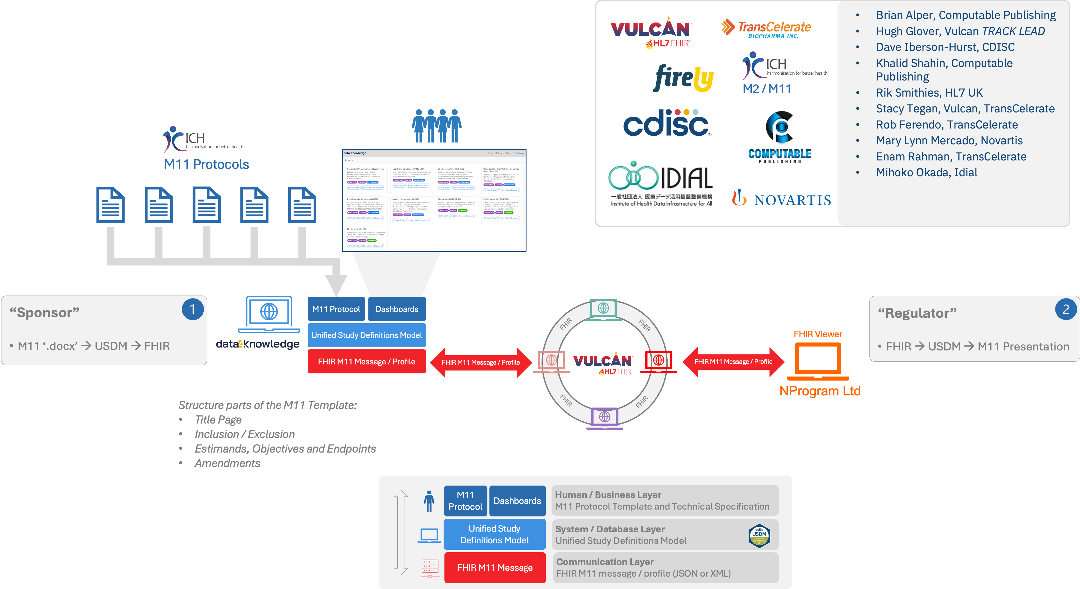
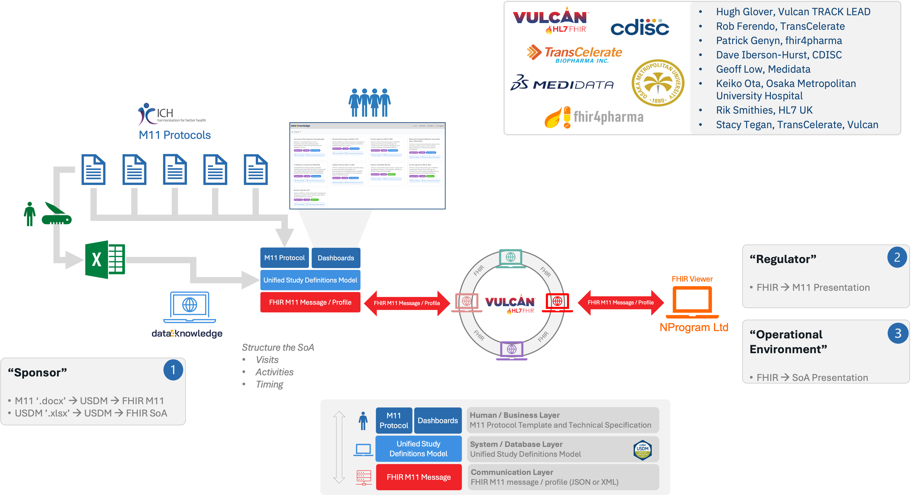
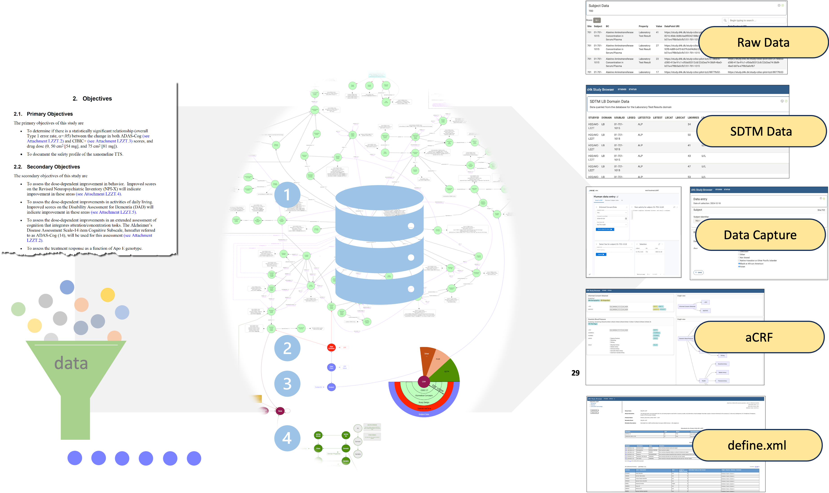

CDISC USDM & ICH M11: Practical electronic Protocols
With CDISC's Unified Study Definition Model (USDM) and ICH's M11 Clinical Electronic Structured Harmonized Protocol (CESHARP) both being released this month we are witnessing a revolution in how sponsor companies operate. Say goodbye to outdated silos and hello to dynamic, data-centric workflows! These powerful standards, working in tandem, promise to completely transform industry operations. This poster details the connection between USDM and the M11 template and discusses the implementation efforts already underway.
USDM & M11
From Theory to Reality
ICH M11, USDM, and FHIR M11 message integration has moved beyond concept to practical implementation at two major HL7 connectathons in 2024. The Dallas and Atlanta events showcased transmission of M11 protocols between systems—proving these standards work together
This same technology is already driving innovation in the FDA PRISM pilot.
FHIR Schedule of Activities Message
At the January 2025 HL7 virtual Connectathon, teams showcased the seamless integration of USDM with the Schedule of Activities (SoA) message standard.
The demonstration proved that critical Schedule of Activities data stored in USDM can now be flawlessly transmitted to receiving systems through the HL7 SoA message pathway.
Unleashing USDM
USDM isn't just another standard—it's a versatile powerhouse with countless applications! The innovative d4k technology demonstrator takes USDM to the next level by extending the model into operational territories never before explored.
This infographic maps the crucial relationship between the M11 Template Specification and the Unified Study Definition Model (USDM), clearly demonstrating how USDM provides comprehensive support for ICH's innovative M11 standard.
The infographic breaks down each M11 element, precisely identifying where and how it's supported within the USDM framework—creating a visual roadmap for seamless integration between the standards.
This groundbreaking demonstrator reveals how USDM creates the solid foundation needed to revolutionize downstream processes including the auto generation of SDTM datasets
Poster developed by D Iberson-Hurst, data4knowledge ApS, for the PHUSE EU CSS Meeting. Contact: dih@data4knowledge.dk

